Slide 1
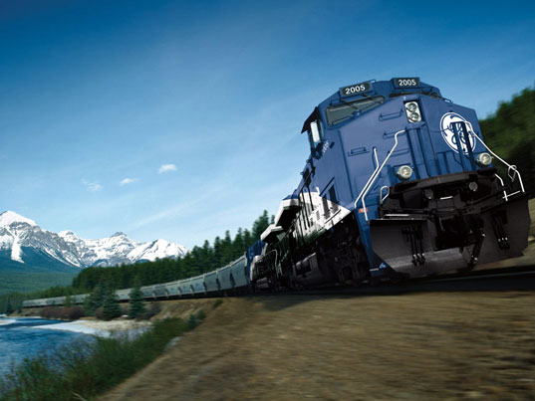
Railroad Block Signal
Railroad Block Signal Software Tool
Team Members:
Kenneth Truex
Chad Mason
Zachary McHenry
Christopher Diebold

Slide 2
Previous Goals
Task | Completion % | Kenneth Truex | Christopher Diebold | Chad Mason | Zachary McHenry | To Do

Slide 3
Milestone 3 Accomplishment Summary

Slide 6
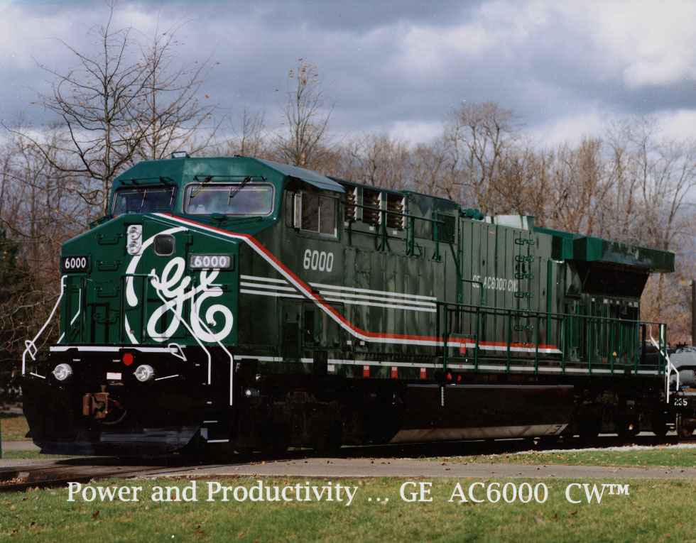
Next Milestone

Slide 7
Milestone 4

Slide 8
Milestone 4 Role Distribution
Task | Kenneth Truex | Christopher Diebold | Chad Mason | Zachary McHenry

Slide 9
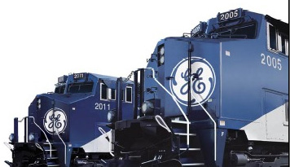
Any Questions?

